Slide 1
Computer Networking basic
SIGNALS
Link Layer Basics
Copyright © CMU, 2007-2011.

Slide 2
Last Time
Application Layer
Example Protocols
  ftp
  http
Performance
Application
Presentation
Session
Transport
Network
Datalink
Physical
F'11
Lecture 4: Physical Layer

Slide 3
Today (and beyond)
Physical layer.
Datalink layer introduction, framing, error coding, switched networks.
Broadcast-networks, home networking.
Application
Presentation
Session
Transport
Network
Datalink
Physical
F'11
Lecture 4: Physical Layer

Slide 4
Transferring Information
Information transfer is a physical process
In this class, we generally care about
  Electrical signals (on a wire)
  Optical signals (in a fiber)
  More broadly, EM waves
Information carriers can also be ?
F'11
Lecture 4: Physical Layer
Notes:
15-745 Lecture 4b
© Seth Copen Goldstein 2001-2

Slide 5
Transferring Information
Information transfer is a physical process
In this class, we generally care about
  Electrical signals (on a wire)
  Optical signals (in a fiber)
  More broadly, EM waves
Information carriers can also be
  Sound waves
  Quantum states
  Proteins
  Ink & paper, etc.
F'11
Lecture 4: Physical Layer
Notes:
15-745 Lecture 4b
© Seth Copen Goldstein 2001-2

Slide 6
From Signals to Packets
Packet
Transmission
Sender
Receiver
Application
Packets
0100010101011100101010101011101110000001111010101110101010101101011010111001
Presentation
Header/Body
Header/Body
Header/Body
Session
Transport
Bit Stream
0 0 1 0 1 1 1 0 0 0 1
Network
Datalink
“Digital” Signal
Physical
Analog Signal
F'11
Lecture 4: Physical Layer

Slide 7
From Signals to Packets
Packet
Transmission
Sender
Receiver
Packets
0100010101011100101010101011101110000001111010101110101010101101011010111001
Header/Body
Header/Body
Header/Body
Bit Stream
0 0 1 0 1 1 1 0 0 0 1
“Digital” Signal
Analog Signal
F'11
Lecture 4: Physical Layer

Slide 8
Today’s Lecture
Modulation.
Bandwidth limitations.
Frequency spectrum and its use.
Multiplexing.
Media: Copper, Fiber, Optical, Wireless.
(Next Week
  Coding.
  Framing.)
F'11
Lecture 4: Physical Layer

Slide 9
Why Do We Care?
Get the big picture.
Physical layer places constraints on what the network infrastructure can deliver
  Reality check
  Impact on system performance
  Impact on the higher protocol layers
  Some examples:
    Fiber or copper?
    Do we need wires?
    Error characteristic and failure modes
    Effects of distance
F'11
Lecture 4: Physical Layer

Slide 10
Baseband vs Carrier Modulation
Baseband modulation: send the “bare” signal.
Carrier modulation: use the signal to modulate a higher frequency signal (carrier).
  Can be viewed as the product of the two signals
  Corresponds to a shift in the frequency domain
F'11
Lecture 4: Physical Layer

Slide 11
Modulation
Changing a signal to convey information
From Music:
  Volume
  Pitch
  Timing
F'11
Lecture 4: Physical Layer
Notes:
15-745 Lecture 4b
© Seth Copen Goldstein 2001-2

Slide 12
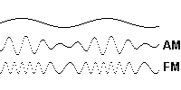
Modulation
Changing a signal to convey information
Ways to modulate a sinusoidal wave
  Volume: Amplitude Modulation (AM)
  Pitch: Frequency Modulation (FM)
  Timing: Phase Modulation (PM)
In our case, modulate signal to encode a 0 or a 1.
(multi-valued signals sometimes)
F'11
Lecture 4: Physical Layer
Notes:
15-745 Lecture 4b
© Seth Copen Goldstein 2001-2

Slide 13
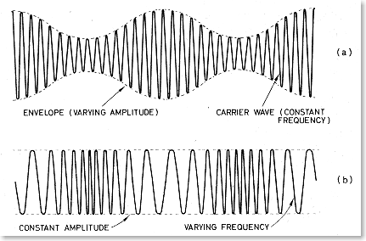
Amplitude Modulation
AM: change the strength of the signal.
Example: High voltage for a 1, low voltage for a 0
0 0 1 1 0 0 1 1 0 0 0 1 1 1 0 0 0 1 1 0 0 0 1 1 1 0
1 0 1 0 1
F'11
Lecture 4: Physical Layer
Notes:
AM, SSB: power requirements
On-off keying
15-745 Lecture 4b
© Seth Copen Goldstein 2001-2

Slide 14
Frequency Modulation
FM: change the frequency
0 1 1 0 1 1 0 0 0 1
F'11
Lecture 4: Physical Layer

Slide 15
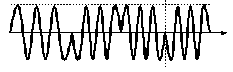
Phase Modulation
PM: Change the phase of the signal
1 0 1 0
F'11
Lecture 4: Physical Layer
Notes:
15-745 Lecture 4b
© Seth Copen Goldstein 2001-2

Slide 16
Amplitude Carrier Modulation
Amplitude
Amplitude
Signal
Carrier
Frequency
Modulated
Carrier
F'11
Lecture 4: Physical Layer

Slide 17
Why/Why Not Baseband?
Baseband
  Simpler hardware
Modulated Carrier
  Control the range of frequencies used
  Wire and electronics at 100Hz can behave very differently from wire and electronics at 10MHz
Carrier freq. ± few percent →
well-behaved and easy to process
Amplitude
Baseband
Modulated
Highest frequencies many times higher than low frequencies → may cause problems
F'11
Lecture 4: Physical Layer

Slide 18
Why Different Modulation
Methods?
F'11
Lecture 4: Physical Layer
Notes:
15-745 Lecture 4b
© Seth Copen Goldstein 2001-2

Slide 19
Why Different Modulation
Methods?
Transmitter/Receiver complexity
Power requirements
Bandwidth
Medium (air, copper, fiber, …)
Noise immunity
Range
Multiplexing
F'11
Lecture 4: Physical Layer
Notes:
15-745 Lecture 4b
© Seth Copen Goldstein 2001-2

Slide 20
What Do We Care About?
Cost
How much bandwidth can I get out of a specific wire (transmission medium)?
What limits the physical size of the network?
How can multiple hosts communicate over the same wire at the same time?
How can I manage bandwidth on a transmission medium?
How do the properties of copper, fiber, and wireless compare?
F'11
Lecture 4: Physical Layer

Slide 21
Bandwidth
Bandwidth is width of the frequency range in which the Fourier transform of the signal is non-zero. (At what frequencies is there energy?)
Sometimes referred to as the channel width
Or, where it is above some threshold value
(Usually, the half power threshold, e.g., -3dB)
dB
  Short for decibel
  Defined as 10 * log₁₀(P₁/P₂)
  When used for signal to noise: 10 * log₁₀(P_{S}/P_{N})
F'11
Lecture 4: Physical Layer
Notes:
15-745 Lecture 4b
© Seth Copen Goldstein 2001-2

Slide 22
Signal = Sum of Waves
=
+ 1.3 X
+ 0.56 X
+ 1.15 X
F'11
Lecture 4: Physical Layer

Slide 23
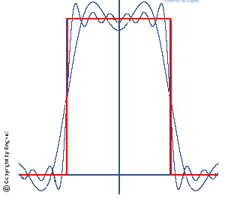
The Frequency Domain
A (periodic) signal can be viewed as a sum of sine waves of different strengths.
  Corresponds to energy at a certain frequency
Every signal has an equivalent representation in the frequency domain.
  What frequencies are present and what is their strength (energy)
E.g., radio and TV signals.
F'11
Lecture 4: Physical Layer

Slide 24
The Nyquist Limit
A noiseless channel of width H can at most transmit a binary signal at a rate 2 x H.
  Assumes binary amplitude encoding: 1→1.0, 0→ -1.0
0 0 1 0 0 0 1 1 1 0 0 0 1 0 1 0 0 1 1 0
F'11
Lecture 4: Physical Layer
Notes:
Phoneline bandpass limited to ~3200Hz
What can a modem do?

Slide 25
The Nyquist Limit
A noiseless channel of width H can at most transmit a binary signal at a rate 2 x H.
  Assumes binary amplitude encoding
  E.g. a 3000 Hz channel can transmit data at a rate of at most 6000 bits/second?
0 0 1 0 0 0 1 1 1 0 0 0 1 0 1 0 0 1 1 0
Hmm, I once bought a modem that did 54K????
F'11
Lecture 4: Physical Layer
Notes:
Phoneline bandpass limited to ~3200Hz
What can a modem do?

Slide 26
How to Get Past the Nyquist Limit
Instead of 0/1, use lots of different values.
(Remember, the channel is noiseless.)
Can we really send an infinite amount of info/sec?
0 0 1 0 0 0 1 1 1 0 ? 0 1 0 1 0 0 1 1 0
F'11
Lecture 4: Physical Layer
Notes:
15-745 Lecture 4b
© Seth Copen Goldstein 2001-2

Slide 27
Past the Nyquist Limit
Every transmission medium supports transmission in a certain fixed frequency range.
The channel bandwidth is determined by the transmission medium and the quality of the transmitter and receivers.
More aggressive encoding can increase the channel bandwidth ... to a point ...
F'11
Lecture 4: Physical Layer
Notes:
PSK: phase-shift keying

Slide 28
Capacity of a Noisy Channel
Can’t add infinite symbols
  you have to be able to tell them apart.
  This is where noise comes in.
F'11
Lecture 4: Physical Layer

Slide 29
Capacity of a Noisy Channel
Can’t add infinite symbols
  you have to be able to tell them apart.
  This is where noise comes in.
Shannon’s theorem:
C = B x log₂(1 + S/N)
  C: maximum capacity (bps)
  B: channel bandwidth (Hz)
  S/N: signal to noise (power) ratio of the channel
  Often expressed in decibels (db) ::= 10 log(S/N)
.
F'11
Lecture 4: Physical Layer

Slide 30
Capacity of a Noisy Channel
Can’t add infinite symbols
  you have to be able to tell them apart.
  This is where noise comes in.
Shannon’s theorem:
C = B x log₂(1 + S/N)
  C: maximum capacity (bps)
  B: channel bandwidth (Hz)
  S/N: signal to noise ratio of the channel
  Often expressed in decibels (db) ::= 10 log(S/N)
Example:
  Local loop bandwidth: 3200 Hz
  Typical S/N: 1000 (30db)
  What is the upper limit on capacity?
    3200 x log₂(1 + 1000) = 31.895 kbits/s
F'11
Lecture 4: Physical Layer
Notes:
3200*9.967226 =31895.12
3200*9=28.8K

Slide 31
Transmission Channel
Considerations
Every medium supports transmission in a certain frequency range.
  Outside this range, effects such as attenuation degrade the signal too much
Transmission and receive hardware will try to maximize the useful bandwidth in this frequency band.
  Tradeoffs between cost, distance, bit rate
As technology improves, these parameters change, even for the same wire.
Good
Bad
Frequency
Signal
F'11
Lecture 4: Physical Layer

Slide 32
Limits to Speed and Distance
Noise: “random” energy is added to the signal.
Attenuation: some of the energy in the signal leaks away.
Dispersion: attenuation and propagation speed are frequency dependent.
(Changes signal shape)
Effects limit the data rate that a channel can sustain.
  But affects different technologies in different ways
Effects become worse with distance.
  Tradeoff between data rate and distance
F'11
Lecture 4: Physical Layer

Slide 33
Today’s Lecture
Modulation.
Bandwidth limitations.
Frequency spectrum and its use.
Multiplexing.
Media: Copper, Fiber, Optical, Wireless.
(Next Week:
  Coding.
  Framing.)
F'11
Lecture 4: Physical Layer

Slide 34
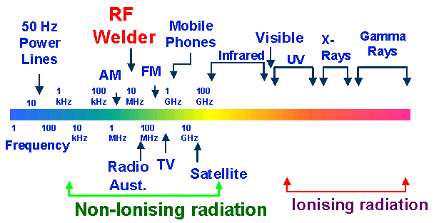
Frequency spectrum and its use.
F'11
Lecture 4: Physical Layer

Slide 35
Today’s Lecture
Modulation.
Bandwidth limitations.
Frequency spectrum and its use.
Multiplexing.
Media: Copper, Fiber, Optical, Wireless.
(Next Week:
  Coding.
  Framing.)
F'11
Lecture 4: Physical Layer

Slide 36
Supporting Multiple Channels
Multiple channels can coexist if they transmit at a different frequency, or at a different time, or in a different part of the space.
  Three dimensional space: frequency, space, time
Space can be limited using wires or using transmit power of wireless transmitters.
Frequency multiplexing means that different users use a different part of the spectrum.
  Similar to radio: 95.5 versus 102.5 station
Controlling time (for us) is a datalink protocol issue.
  Media Access Control (MAC): who gets to send when?
F'11
Lecture 4: Physical Layer

Slide 37
Time Division Multiplexing
Different users use the wire at different points in time.
Requires spectrum proportional to aggregate bandwidth.
1 user
Frequency
2 users
Frequency
F'11
Lecture 4: Physical Layer

Slide 38
FDM: Multiple Channels
Determines Bandwidth of Link
Amplitude
Determines
Bandwidth
of Channel
Different Carrier
Frequencies
F'11
Lecture 4: Physical Layer

Slide 39
Frequency versus
Time-division Multiplexing
With FDM different users use different parts of the frequency spectrum.
  I.e. each user can send all the time at reduced rate
  Example: roommates
With TDM different users send at different times.
  I.e. each user can send at full speed some of the time
  Example: time-share condo
The two solutions can be combined.
Frequency
Frequency
Bands
Frame
Slot
Time
F'11
Lecture 4: Physical Layer

Slide 40
Today’s Lecture
Modulation.
Bandwidth limitations.
Frequency spectrum and its use.
Multiplexing.
Media: Copper, Fiber, Optical, Wireless.
Coding.
Framing.
F'11
Lecture 4: Physical Layer

Slide 41
Copper Wire
Unshielded twisted pair (UTP)
  Two copper wires twisted - avoid antenna effect
  Grouped into cables: multiple pairs with common sheath
  Category 3 (voice grade) versus category 5
  100 Mbit/s up to 100 m, 1 Mbit/s up to a few km
  Cost: ~ 10cents/foot
Coax cables.
  One connector is placed inside the other connector
  Holds the signal in place and keeps out noise
  Gigabit up to a km
Signaling processing research pushes the capabilities of a specific technology.
  E.g. modems, use of cat 5
Images: networkcable-tester.com, tootoo.com
F'11
Lecture 4: Physical Layer

Slide 42
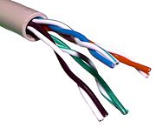
UTP
Why twist wires?
F'11
Lecture 4: Physical Layer
Notes:
15-745 Lecture 4b
© Seth Copen Goldstein 2001-2

Slide 43
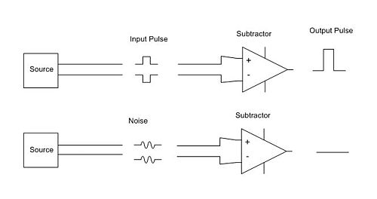
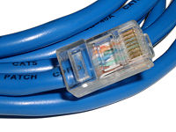
UTP
Why twist wires?
  Provide noise immunity
Combine with Differential Signaling
F'11
Lecture 4: Physical Layer
Notes:
15-745 Lecture 4b
© Seth Copen Goldstein 2001-2

Slide 44
Light Transmission in Fiber
1.0
LEDs
Lasers
tens of THz
loss
(dB/km)
0.5
1.3μ
1.55μ
0.0
1000
1500 nm
(~200 Thz)
wavelength (nm)
F'11
Lecture 4: Physical Layer

Slide 45
Ray Propagation
cladding
core
lower index
of refraction
(note: minimum bend radius of a few cm)
F'11
Lecture 4: Physical Layer

Slide 46
Fiber Types
Multimode fiber.
  62.5 or 50 micron core carries multiple “modes”
  used at 1.3 microns, usually LED source
  subject to mode dispersion: different propagation modes travel at different speeds
  typical limit: 1 Gbps at 100m
Single mode
  8 micron core carries a single mode
  used at 1.3 or 1.55 microns, usually laser diode source
  typical limit: 10 Gbps at 60 km or more
  still subject to chromatic dispersion
F'11
Lecture 4: Physical Layer

Slide 47
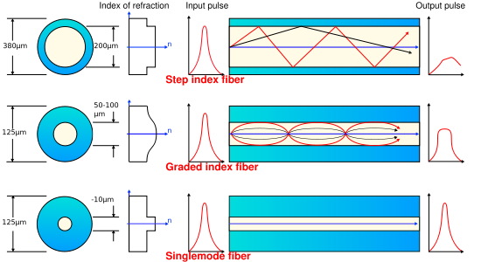
Fiber Types
Multimode
Single mode
F'11
Lecture 4: Physical Layer

Slide 48
Gigabit Ethernet:
Physical Layer Comparison
Medium Transmit/ Distance Comment
receive
Copper 1000BASE-CX 25 m machine room use
Twisted pair 1000BASE-T 100 m four twisted pairs,
IEEE 802.3ab
MM fiber 62 mm 1000BASE-SX 260 m
1000BASE-LX 500 m
MM fiber 50 mm 1000BASE-SX 525 m
1000BASE-LX 550 m
SM fiber 1000BASE-LX 5000 m
Twisted pair 100BASE-T 100 m 2p of UTP5/2-4p of UTP3
MM fiber 100BASE-SX 2000m
F'11
Lecture 4: Physical Layer

Slide 49
How to increase distance?
Even with single mode, there is a distance limit.
I.e.: How do you get it across the ocean?
F'11
Lecture 4: Physical Layer
Notes:
15-745 Lecture 4b
© Seth Copen Goldstein 2001-2

Slide 50
How to increase distance?
Even with single mode, there is a distance limit.
I.e.: How do you get it across the ocean?
pump
laser
source
F'11
Lecture 4: Physical Layer
Notes:
15-745 Lecture 4b
© Seth Copen Goldstein 2001-2

Slide 51
Regeneration and Amplification
At end of span, either regenerate electronically or amplify.
Electronic repeaters are potentially slow, but can eliminate noise.
Amplification over long distances made practical by erbium doped fiber amplifiers offering up to 40 dB gain, linear response over a broad spectrum. Ex: 40 Gbps at 500 km.
pump
laser
source
F'11
Lecture 4: Physical Layer

Slide 52
Wavelength Division Multiplexing
Send multiple wavelengths through the same fiber.
  Multiplex and demultiplex the optical signal on the fiber
Each wavelength represents an optical carrier that can carry a separate signal.
  E.g., 16 colors of 2.4 Gbit/second
Like radio, but optical and much faster
Optical
Splitter
Frequency
F'11
Lecture 4: Physical Layer

Slide 53
Wireless Technologies
Great technology: no wires to install, convenient mobility, …
High attenuation limits distances.
  Wave propagates out as a sphere
  Signal strength attenuates quickly → 1/d³
High noise due to interference from other transmitters.
  Use MAC and other rules to limit interference
  Aggressive encoding techniques to make signal less sensitive to noise
Other effects: multipath fading, security, ..
Ether has limited bandwidth.
  Try to maximize its use
  Government oversight to control use
Huh? 2 in free space,
typically 2 to 6
F'11
Lecture 4: Physical Layer

Slide 54
Things to Remember
Bandwidth and distance of networks is limited by physical properties of media.
  Attenuation, noise, dispersion, …
Network properties are determined by transmission medium and transmit/receive hardware.
  Nyquist gives a rough idea of idealized throughput
  Can do much better with better encoding
    Low b/w channels: Sophisticated encoding, multiple bits per wavelength.
    High b/w channels: Simpler encoding (FM, PCM, etc.), many wavelengths per bit.
  Shannon: C = B x log₂(1 + S/N)
Multiple users can be supported using space, time, or frequency division multiplexing.
Properties of different transmission media:
  copper, optical, wireless.
F'11
Lecture 4: Physical Layer

